Slide 2
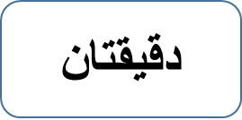
Matching
https://quizlet.com/426667486/match

Slide 3
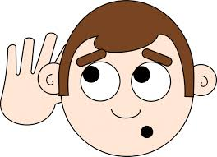
https://drive.google.com/open?id=1_7IpqU137yZY1sZ5esvNfG_Yyh78oxBK

Slide 4
- -رتب أحداث القصة. Sort story events

